Slide 1
Chapter 4
Cellular Metabolism

Slide 2
Copyright©The McGraw-Hill Companies, Inc. Permission required for reproduction or display.
Metabolic Processes
A. Metabolic reactions are of two types: in anabolic reactions, larger molecules are constructed from smaller ones, a process requiring energy.
In catabolic reactions, larger molecules are broken down, releasing energy. The reactions of metabolism are often reversible.

Slide 3
Copyright©The McGraw-Hill Companies, Inc. Permission required for reproduction or display.
B. Anabolism
1. Anabolism provides the substances needed for growth and repair.
2. These reactions occur by dehydration synthesis, removing
a molecule of water to join two smaller molecules.

Slide 4
Copyright©The McGraw-Hill Companies, Inc. Permission required for reproduction or display.
3. Polysaccharides, lipids, and proteins are constructed via dehydration synthesis.
a. To form fats, glycerol and fatty acids bond.
b. The bond between two monosaccharides forms a disaccharidide,while many joined together form a polysaccharide.

Slide 5
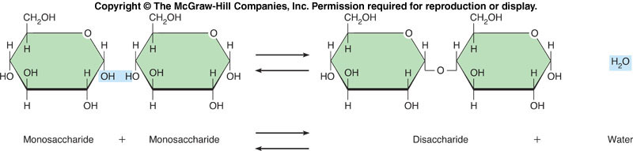
Copyright©The McGraw-Hill Companies, Inc. Permission required for reproduction or display.

Slide 6
Copyright©The McGraw-Hill Companies, Inc. Permission required for reproduction or display.
C. Catabolism
1. Catabolism breaks apart larger molecules into their building blocks.
2. These reactions occur by hydrolysis, wherein a molecule of water is inserted into a polymer which is
split into two smaller molecules.

Slide 7
Copyright©The McGraw-Hill Companies, Inc. Permission required for reproduction or display.
Control of Metabolic Reactions:
A. Enzymes control the rates of all the metabolic reactions of the cell.
B. Enzyme Action
1. Enzymes are complex proteins that function to lower the activation energy of a reaction so it may begin and proceed more rapidly. Enzymes are called catalysts.

Slide 8
Copyright©The McGraw-Hill Companies, Inc. Permission required for reproduction or display.
2. Enzymes work in small quantities and are recycled by the cell.
3. Each enzyme is specific, acting on only one kind of substrate.

Slide 9
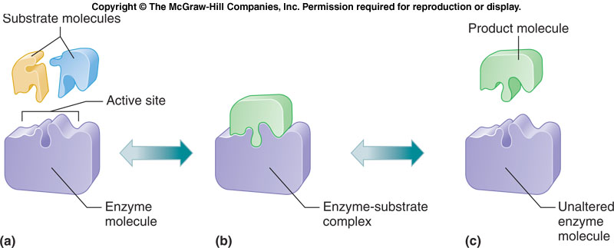
Copyright©The McGraw-Hill Companies, Inc. Permission required for reproduction or display.
C. Factors That Alter Enzymes
1. Enzymes (proteins) can be denatured by heat, pH extremes, chemicals, electricity, radiation,
and by other causes.

Slide 10
Copyright©The McGraw-Hill Companies, Inc. Permission required for reproduction or display.
Energy for Metabolic Reactions:
A. Energy is the capacity to do work.
B. Common forms of energy include heat, light, and sound, and electrical, mechanical, and chemical energy.

Slide 11
Copyright©The McGraw-Hill Companies, Inc. Permission required for reproduction or display.
C. Release of Chemical Energy - Cellular Respiration
1. Release of chemical energy in the cell often occurs through the oxidation of glucose.
2. Burning glucose requires energy to begin the process.

Slide 12
Copyright©The McGraw-Hill Companies, Inc. Permission required for reproduction or display.
3. The end-products of these reactions are heat as well as stored energy.
4. This stored energy is called ATP which has a chain of three phosphates.

Slide 13
Copyright©The McGraw-Hill Companies, Inc. Permission required for reproduction or display.
D. ATP Molecules
1. Up to 38 molecules of ATP are produced for each molecule of glucose oxidized.
2. ATP molecules contain three phosphates in a chain.

Slide 14
Copyright©The McGraw-Hill Companies, Inc. Permission required for reproduction or display.
E. Anaerobic Respiration
1. The first part of cellular respiration is the splitting of 6-C glucose that occurs through a series of enzyme-catalyzed steps called glycolysis.

Slide 15
Copyright©The McGraw-Hill Companies, Inc. Permission required for reproduction or display.
3. Glycolysis occurs in the cytosol and does not require oxygen (is anaerobic).
4. Energy from ATP is used to start the process but there is a net gain of energy as a result.

Slide 16
Copyright©The McGraw-Hill Companies, Inc. Permission required for reproduction or display.
F. Aerobic Respiration
1. Oxygen is needed for aerobic respiration, which occurs within the mitochondria.
2. There is a much greater gain of ATP molecules from aerobic respiration.
3. The final products of glucose oxidation are carbon dioxide, water, and energy.

Slide 17
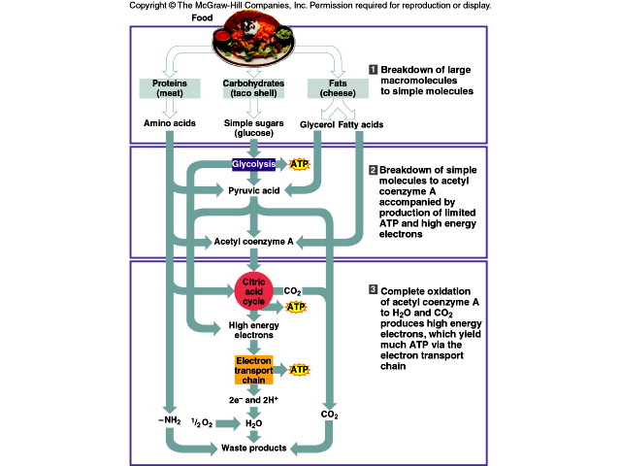
Copyright©The McGraw-Hill Companies, Inc. Permission required for reproduction or display.

Slide 18
Copyright©The McGraw-Hill Companies, Inc. Permission required for reproduction or display.
Metabolic Pathways:
A. The enzymes controlling either an anabolic or catabolic sequence of reactions must act in a specific order.
B. A sequence of enzyme-controlled reactions is called a metabolic pathway.

Slide 19
Copyright©The McGraw-Hill Companies, Inc. Permission required for reproduction or display.
C. Regulation of Metabolic Pathways
1. The rate of a metabolic pathway is determined by a regulatory enzyme responsible for one of its steps.
2. A rate-limiting enzyme is the first step in a series.

Slide 20
Copyright©The McGraw-Hill Companies, Inc. Permission required for reproduction or display.
Nucleic Acids
A. Deoxyribonucleic acid (DNA) contains the genetic code needed for the synthesis of each protein (including enzymes).
B. Genetic Information
1. A gene is a portion of a DNA molecule that contains the genetic information for making a single protein. The genome is all the DNA .

Slide 21
Copyright©The McGraw-Hill Companies, Inc. Permission required for reproduction or display.
C. DNA Molecules
1. The nucleotides of DNA form a sugar-phosphate backbone with bases extending into the interior of the DNA molecule.
2. The nucleotides of one DNA strand are compatible to those in the other strand (adenine pairs with thymine; cytosine with guanine) and so exhibit complementary base pairing.

Slide 22
Copyright©The McGraw-Hill Companies, Inc. Permission required for reproduction or display.
3. The DNA molecule twists to form a double helix and may be millions of base pairs long.

Slide 23
Copyright©The McGraw-Hill Companies, Inc. Permission required for reproduction or display.
D. DNA Replication
1. Each new cell must be provided with an exact replica of the parent cell's DNA.
2. DNA replication occurs during interphase.
a. The DNA molecule splits.
b. Nucleotides form complementary pairs with the original strands.

Slide 24
Copyright©The McGraw-Hill Companies, Inc. Permission required for reproduction or display.
3. Each new DNA molecule consists of one parental strand and one newly synthesized strand of DNA.

Slide 25
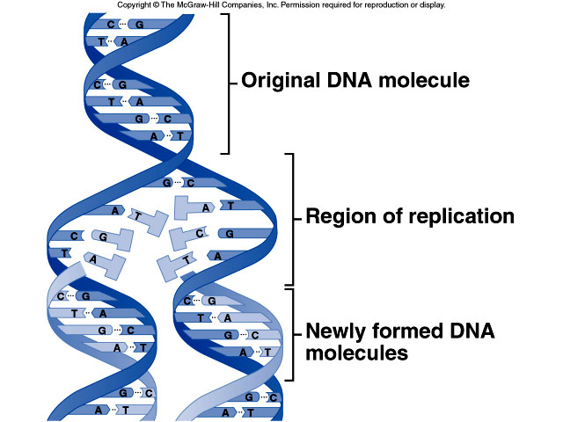
Copyright©The McGraw-Hill Companies, Inc. Permission required for reproduction or display.

Slide 26
Copyright©The McGraw-Hill Companies, Inc. Permission required for reproduction or display.
E. Protein Synthesis
1. In the cytoplasm, a second kind of RNA, called transfer RNA, has a triplet of nucleotides called the anticodon, which is complementary to nucleotides of the messenger RNA codon.
2. The ribosome holds the messenger RNA in position while the transfer RNA carries in the correct amino acid in sequence, with anticodons matching up to codons.

Slide 27
Copyright©The McGraw-Hill Companies, Inc. Permission required for reproduction or display.
3. The ribosome contains enzymes needed to join the amino acids together.
4. As the amino acids are joined, the new protein molecule changes into
its unique shape.

Slide 28
Copyright©The McGraw-Hill Companies, Inc. Permission required for reproduction or display.
F. Genetic Code
1. The sequence of nucleotides in a DNA molecule gives the sequence of amino acids for a given protein.
2. This method of storing information for protein synthesis is the genetic code.
3. RNA molecules copy and transfer this information to the cytoplasm where proteins are manufactured.

Slide 29
Copyright©The McGraw-Hill Companies, Inc. Permission required for reproduction or display.
G. RNA Molecules
1. RNA molecules are single-stranded and contain ribose rather than deoxyribose, and uracil rather than thymine.
2. Messenger RNA (mRNA) molecules are synthesized in the nucleus in a sequence complementary to the DNA template in a process called transcription.

Slide 30
Copyright©The McGraw-Hill Companies, Inc. Permission required for reproduction or display.
3. Each amino acid corresponds to a triplet of DNA nucleotides; a triplet of nucleotides in messenger RNA is called a codon.
4. Messenger RNA can move out of the nucleus and associate with ribosomes in the cytoplasm where the protein will be constructed in a process called translation.

Slide 31
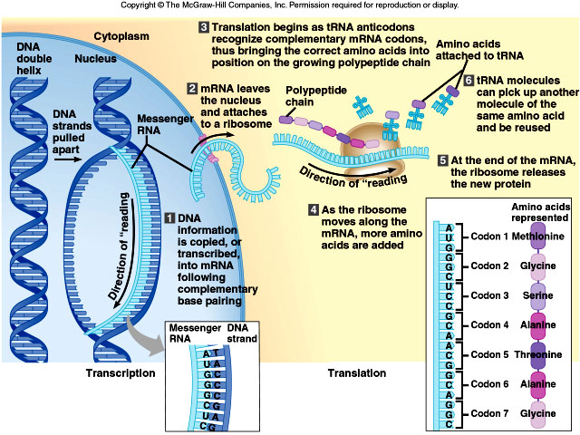
Copyright©The McGraw-Hill Companies, Inc. Permission required for reproduction or display.

Slide 32
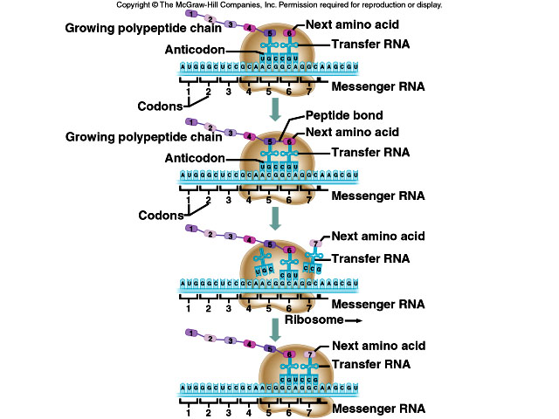
Copyright©The McGraw-Hill Companies, Inc. Permission required for reproduction or display.

